Slide 1
Telecom Churn
By: Manas, Gabriel, Truett, Yuke

Slide 2
1 Dataset Description
2 Exploratory Analysis
3 Model Building
4 Recommendations
Agenda

Slide 3
Customer churn rate is the percentage of customers or subscribers who cancel or don't renew their subscriptions during a given time period
Notes:
This is how churn rate is defined. The churn rate of our data set is 49%. This churn rate is unusually high because of the circumstances of the coding competition. The average annual churn rate of telecom companies ranges from 23-46%. Our assumption is that the telecom company that gave the data for the competition had pre-filtered the data based on who they thought would be potential churners.

Slide 4
Data Introduction
Calibration data of 100,000 customers
100,000 rows and 100 columns
Contains variables that concern the telecom industry, demographics of customers, and much more
Data set is from a coding competition trying to predict potential churners
Notes:
Contains variables that include monthly revenue, monthly minutes, and cell phone price to demographic variables like race,if they are a homeowner, and income.
This data was compiled for customers over a three month period for a coding competition, where the objective was to predict potential churners and come up with solutions to reduce churn. After a 1 month lag period to try and stop potential churners with incentives to stay the actual churn rate was recalculated.

Slide 5
Why would you switch your network?
Notes:
Ask class: So why would you choose to switch your network?

Slide 6
What causes churn in telecom industry?
Is it because of poor service quality?
Are there behavior or demographic trends?
Could logistic issues be large factors?
Notes:
So what causes churn in the telecom industry?
Is it mainly because of bad service reception?
Or could it be based of the characteristics of the customer?
There are many possibilities and we will try to answer these questions

Slide 7
Exploratory Analysis - Phone Variables
Notes:
Thanks yuke, Lets try to answer some of the questions posed through exploring the phone variables and time trends of churn

Slide 8
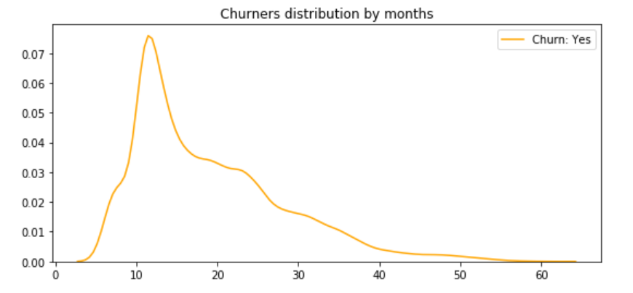
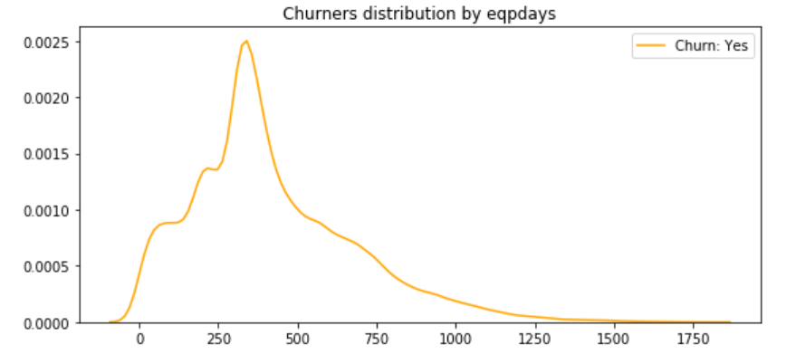
Maximum churn happens when users reach 1 year mark
Notes:
These two graphs show the distribution of what time period customers churned based on months with the company on the top graph and how old customers phones where on the bottom graph. Customers tend to churn around the 10 - 24 month period. Customers also tend to churn when their phones are 8 to 16 months old. Both graphs show a spike at 1 year.

Slide 9
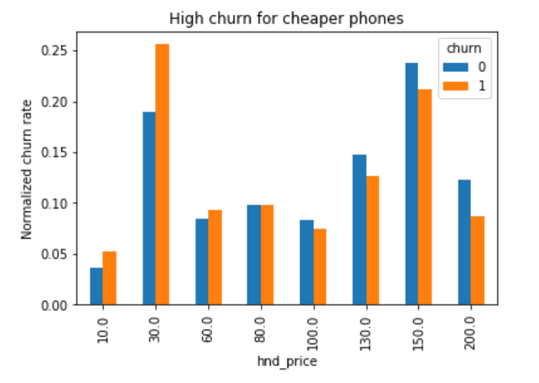
Low-end phone users tend to churn more
Notes:
This graph shows the normalized churn rate of customers by the price of of their cell phone. So 30 dollar phones and 150 dollar phones are the most popular phones… definitely shows this data sets age. cheap phone customers tend to churn more than pricey phone customers as seen when you compare the difference between the blue and orange bars.

Slide 10
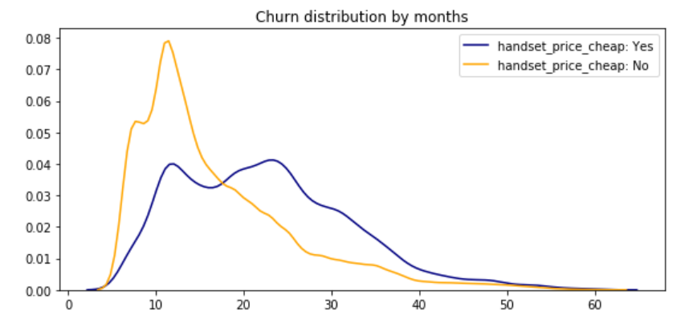
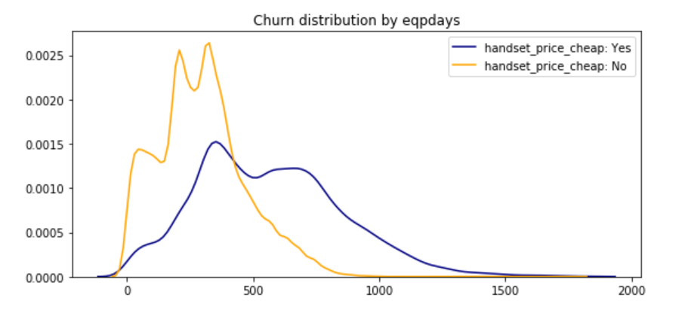
Low-end phone users tend to churn sooner
Notes:
This is a graph that is very similar to a couple slides ago, but its separated by if the customer had a cheap phone or not. So the distribution for cheap phones on the top graph, as you can see in yellow, centers around 12 months, but the more expensive phones, seen in blue, have a bimodal distribution with one peak at 12 months and another at 24 months.
Thinking in terms of phone contracts, when you buy a new phone, you tend to pay it off over a specified period of time. Cheaper phones tend to pay off in shorter periods of time say 12 months whereas more expensive phones you can have an option to pay it off in 12 months or 24 months. There seems to be a trend where customers pay off their phones and then churn because another company has a promotional offer or the customer is released from their contract because they payed off their phone.

Slide 11
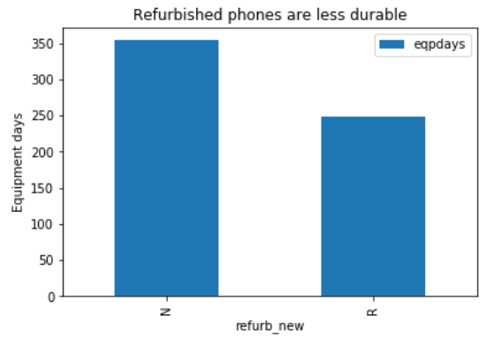
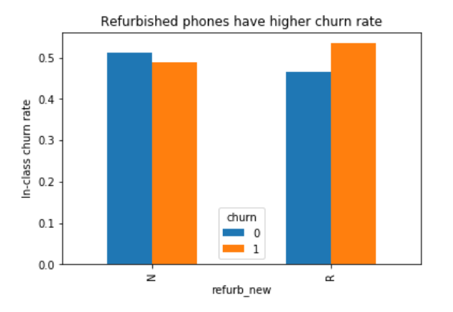
Refurbished phone users - focus on them!
Notes:
Lets start with the left graph, this shows that refurbished phones are less durable meaning that they last fewer days relative to new phones. Notice that new phones last around a year and refurbished phones tend to last 8 months. This is a similar trend to the time most people churn based on the phone age or time with the company.
The right graphs shows that customers who had a refurbished phone, tended to churn more than customers who did not.

Slide 12
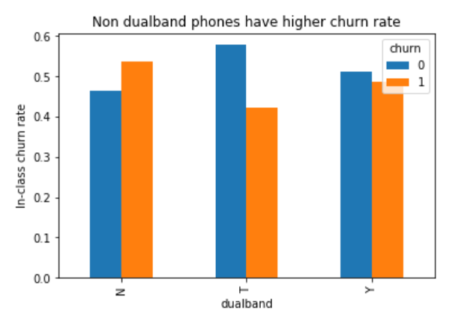
Low-end phone users tend to churn more
Notes:
For this graph, on the x axis, N denotes a single band phone, Y denotes a dual band phone, and T denotes a tri band phone. With more bands enables broader roaming capabilities to users so more bands == better network connection. This shows that single band cell phone users tend to churn more and as you jump from single, dual band, to tri band, the churn rate goes down.

Slide 13
Exploratory Analysis - Demographics and Behavioral

Slide 14
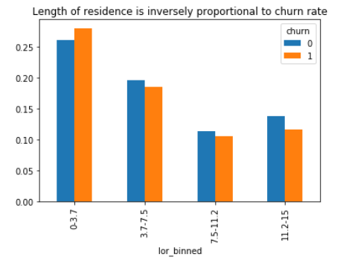
Local residents tend to churn less

Slide 15
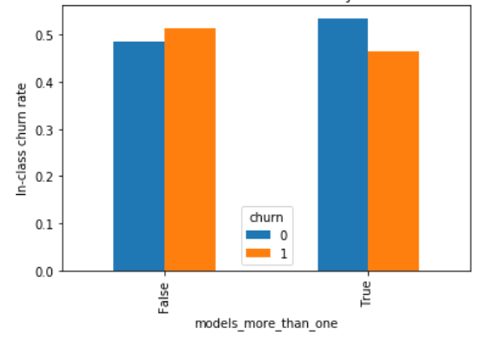
Customers with more than 1 model seem loyal with less churn rate

Slide 16
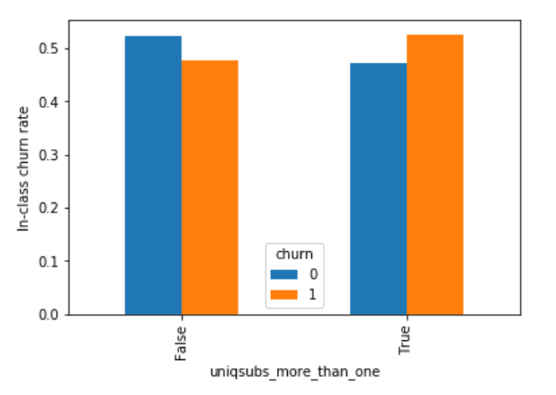
Users in family plan tend to churn more
Notes:
Not good for business losing multiple customers at a time

Slide 17
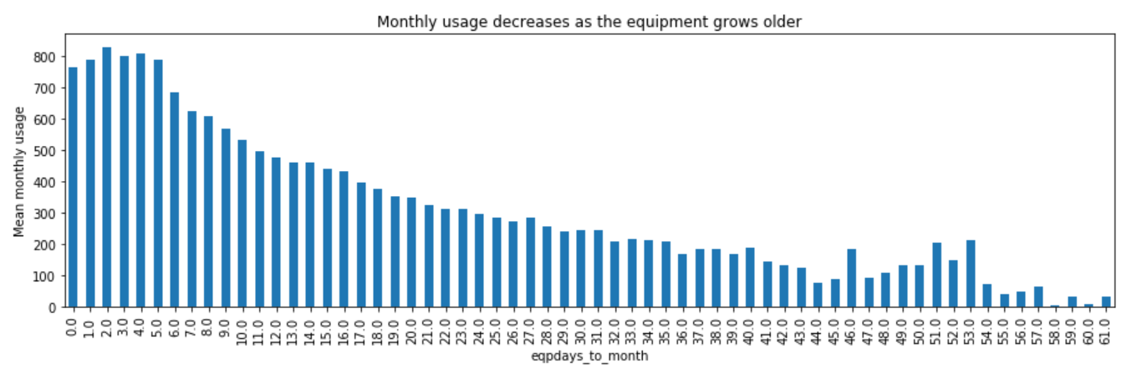
Using old phone is boring?

Slide 18
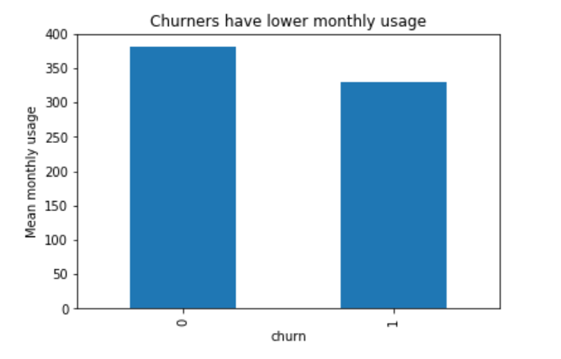
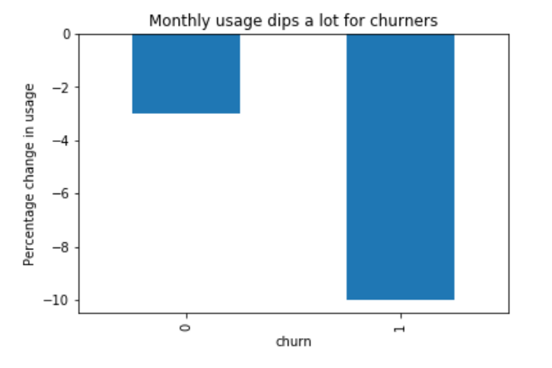
Considerable decline in usage pattern before churn out

Slide 19
Model Building
Random Forest (subset)
Random Forest
Boosting

Slide 20
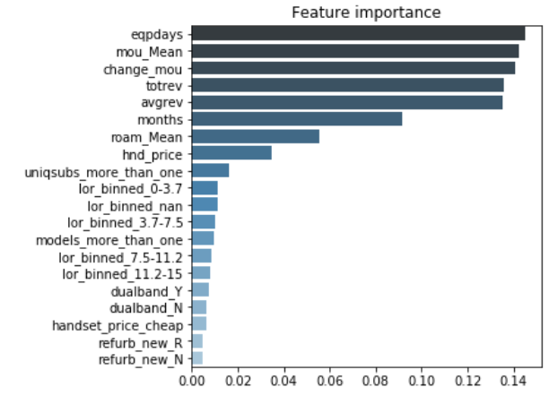
Random Forest with variable subset- 0.646 AUC
Notes:
Using only the 15 important variables out of 100 and 6 engineered variables - filtered through EDA

Slide 21
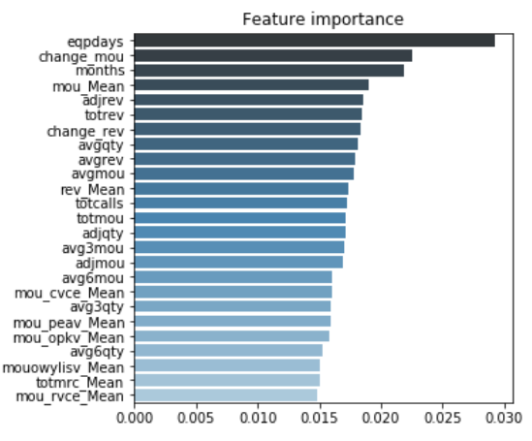
Random Forest - 0.683 AUC

Slide 22
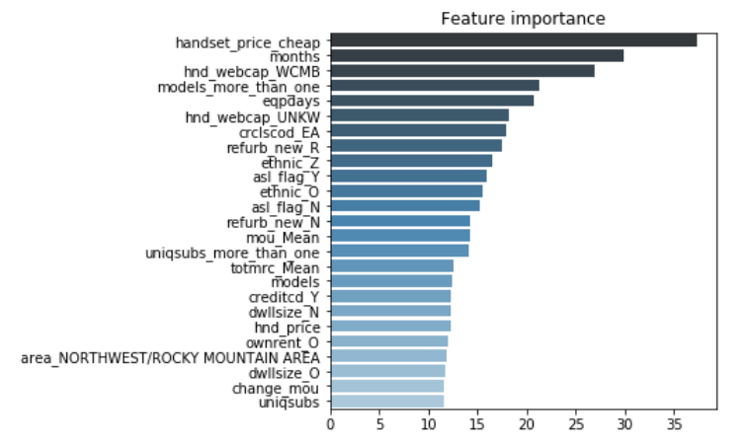
XGBoost- 0.693 AUC

Slide 23
Recommendations
Re-evaluate pricing models and incentivize customer retention
Investigate how new phones and contracts influence customer behavior
Notes:
https://docs.google.com/document/d/1gyQFpOcPoBQ1y8HkWBHjMkrDhnU_pOw5L1mlOS6EfFA/edit?usp=sharing

Slide 24
Thank You!

